Slide 1

NATIONAL PARKS BIODIVERSITY DATABASE
test
Team: Max Becker, Michael Bowman, Anna Howell, and Adrian Williams

Slide 2
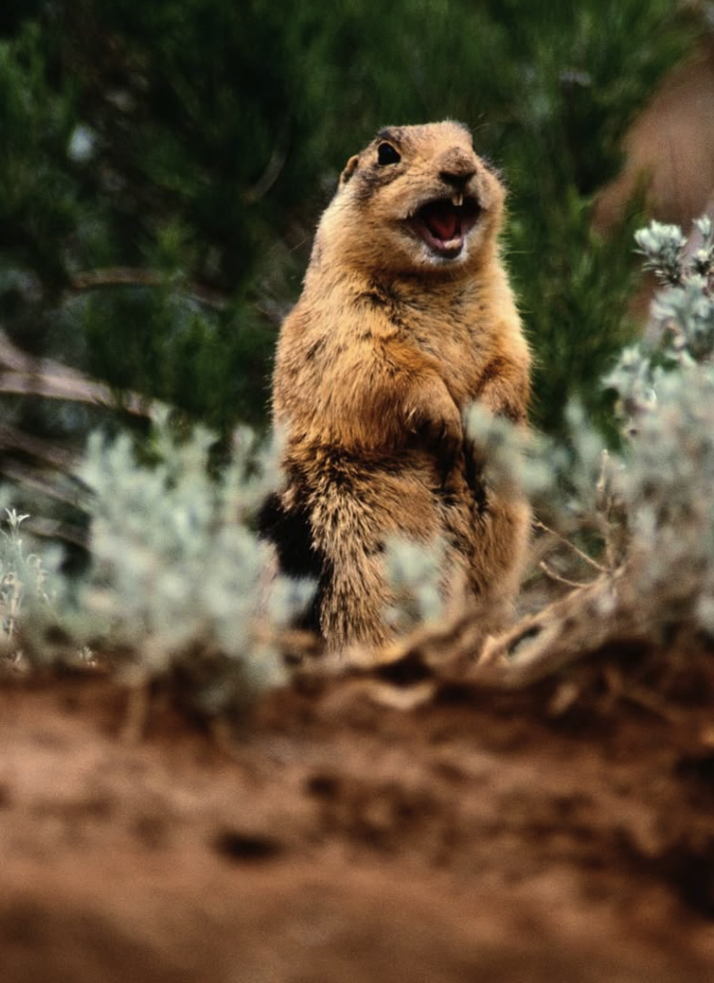
Table of Contents
Project Overview
Data Sources
Technologies Used
ETL Workflow
Connecting to PostgreSQL
Retrieving PostgreSQL
Merging Databases
Reorganizing columns
Saving Output & Closing SQL Connection
Database Design
Ethical Considerations

Slide 3
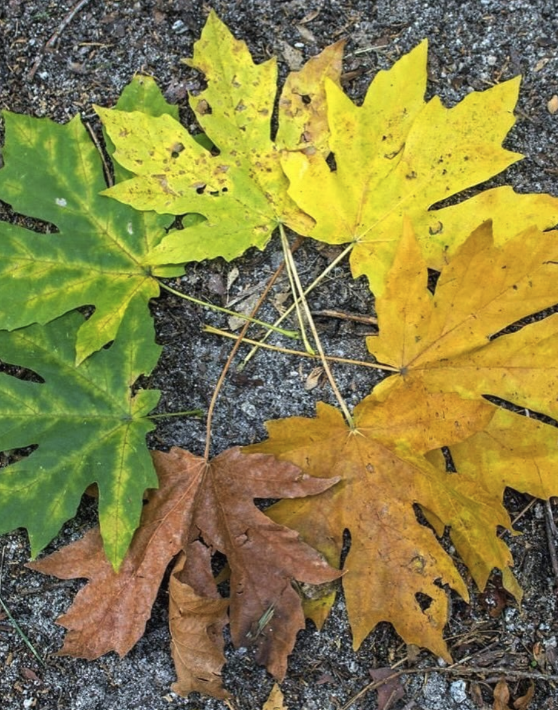
Project Overview
This National Parks Biodiversity Database project investigates the diversity of species observed across 4 U.S. National Parks.
The database also includes relevant geographical and environmental data such as park location and acreage.
By centralizing this information into a structured SQL database, we enable efficient querying and exploration of trends related to conservation efforts, species habitats, and biodiversity richness.

Slide 4

Data Sources
https://www.kaggle.com/datasets/nationalparkservice/park-biodiversity
https://www.kaggle.com/datasets/mathisjander/biodiversity-in-national-parks-project

Slide 5
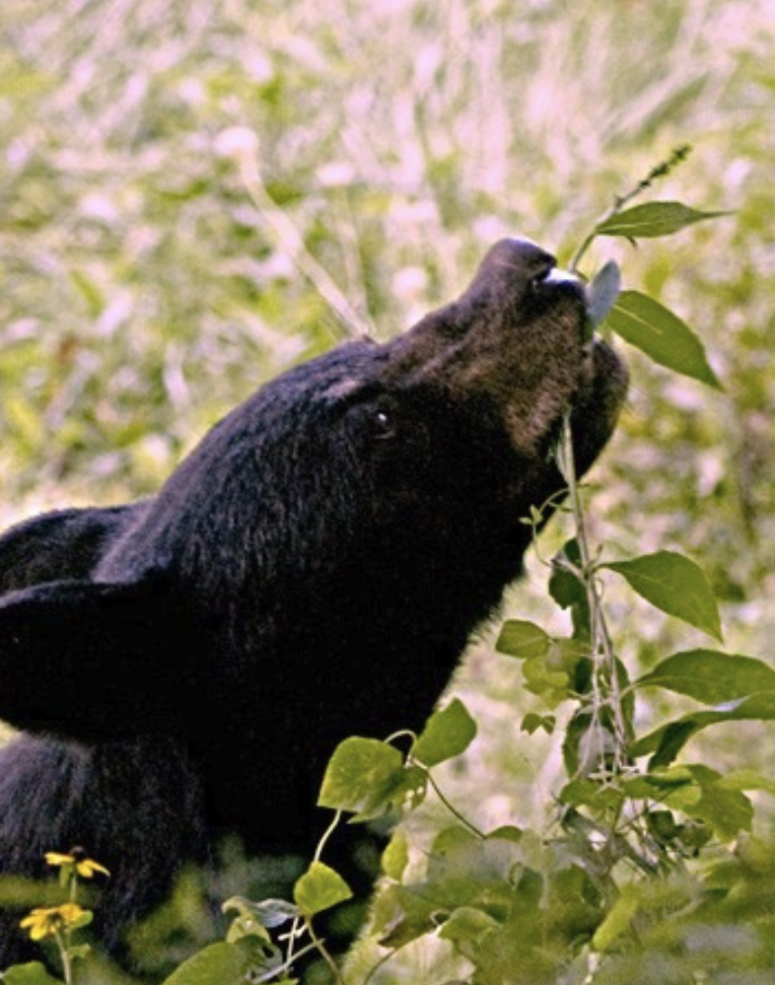
Technologies Used
Jupyter Notebooks
Python
Pandas (for general-purpose data analysis)
Polars (for high-performance column and string operations)
PostgreSQL (via psycopg2 for PostgreSQL access)

Slide 6
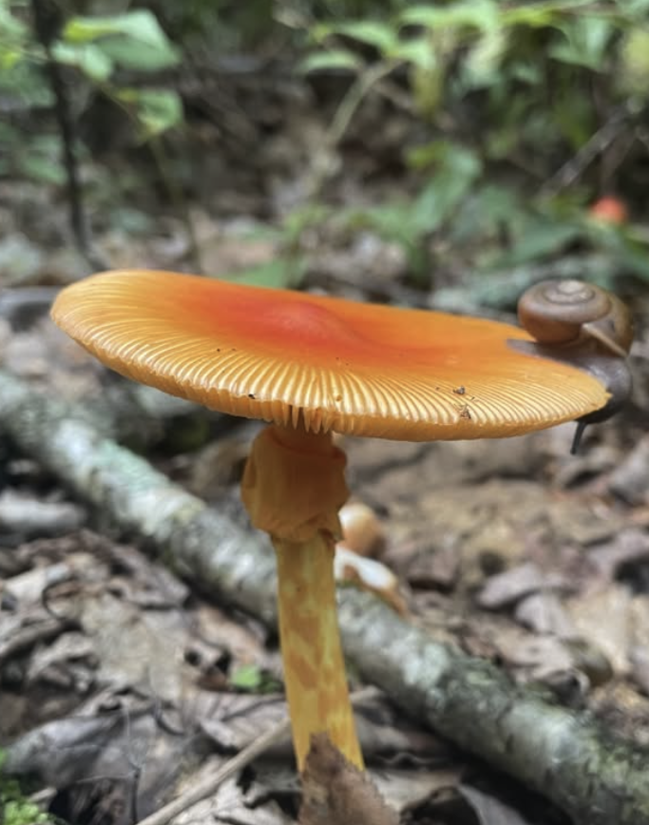
ETL Workflow: Extract
Extracting three primary CSV datasets from Kaggle.com:
Parks.csv (Park metadata)
Observations.csv (Species observations)
Species_info.csv (Species classification and conservation info)

Slide 7
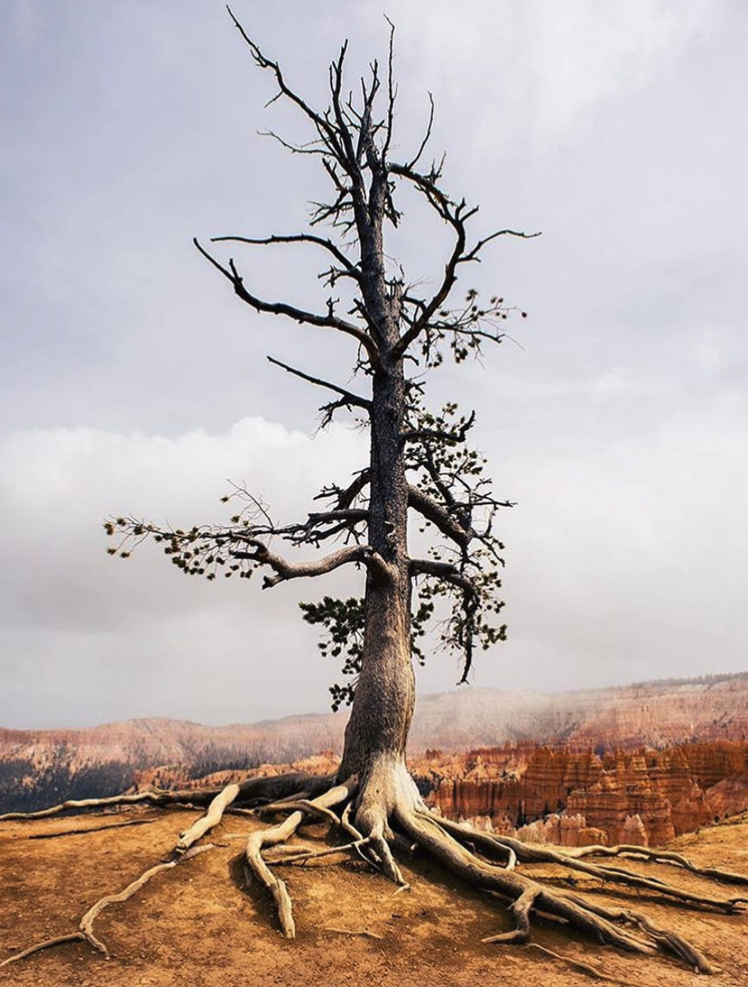
ETL Workflow: Transform
Transforming the data by:
Renaming inconsistent columns
Park Name -> park_name, Park Code -> park_code
Renaming inconsistent park names
Bryce Canyon National Park -> Bryce National Park
Saving the cleaned dataset to a new file called: parks_updated.csv

Slide 8
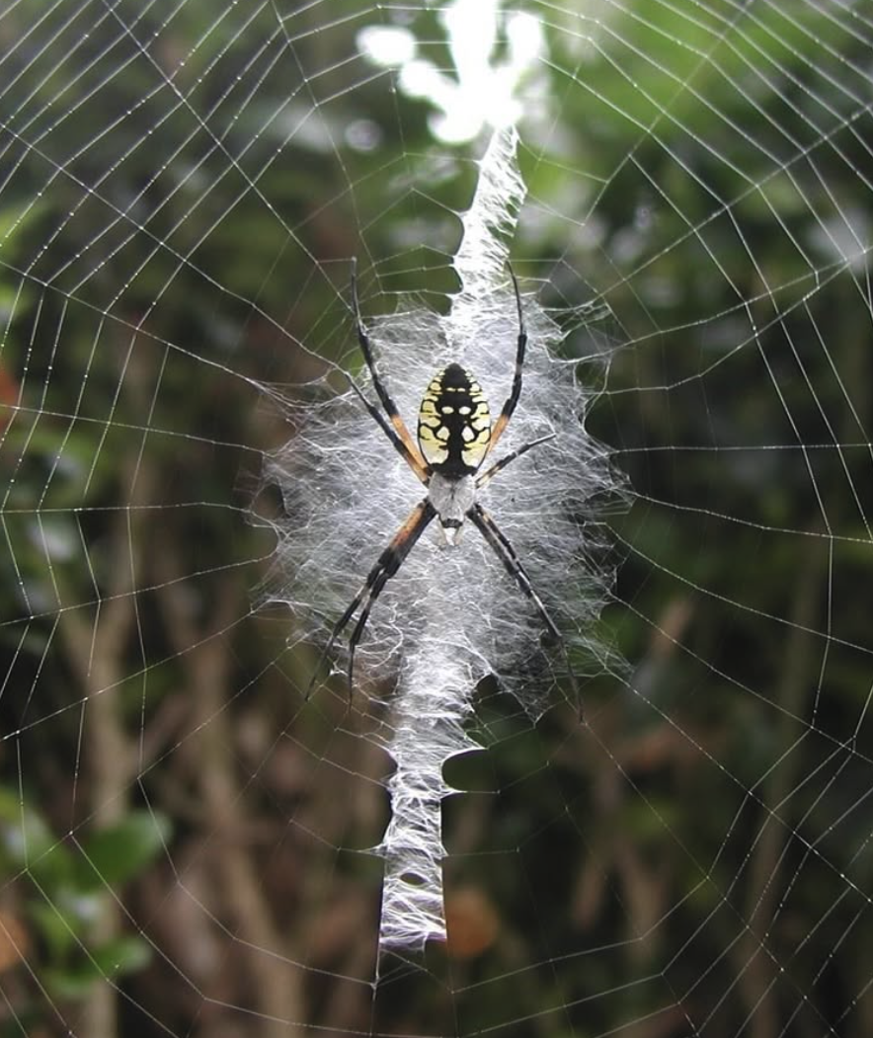
ETL Workflow: Load
Loading the cleaned and joined data into a relational SQLite database (national_park_species_db.sql with 3 tables:
observations, parks_updated, and species_info

Slide 9
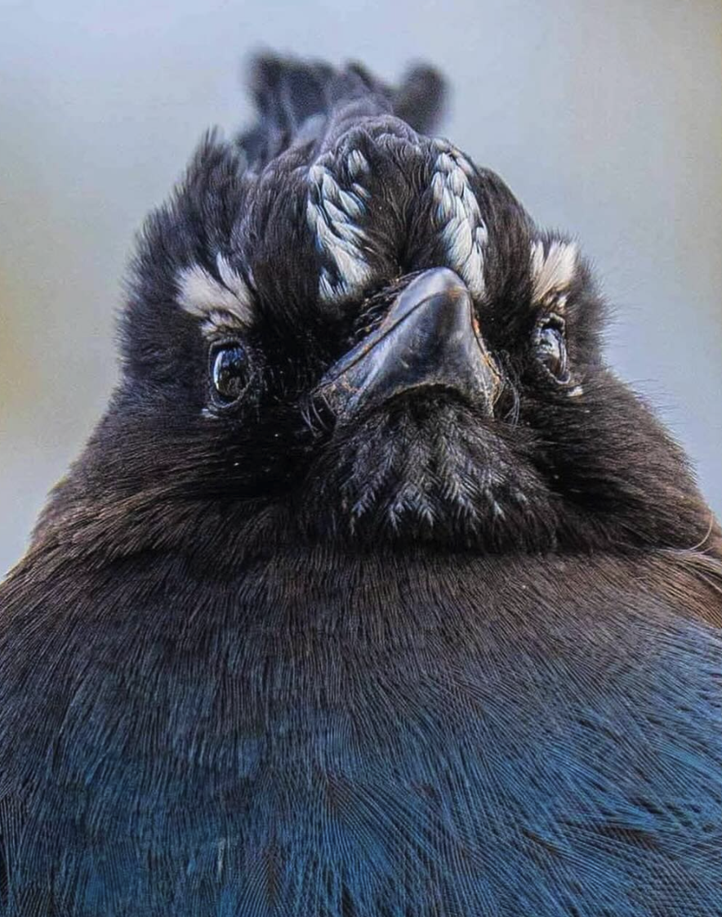
Connecting to PostgreSQL
Connect to the PostgreSQL database that was previously created in pgAdmin4
Create a cursor object that lets you execute SQL commands from Python
Execute SQL to retrieve all rows from the 'observations' table

Slide 10

Retrieving PostgreSQL Database / Tables
Execute SQL to retrieve all rows from the observation, parks_updated, and species_info tables
Print the first 3 rows to confirm data was pulled successfully

Slide 11
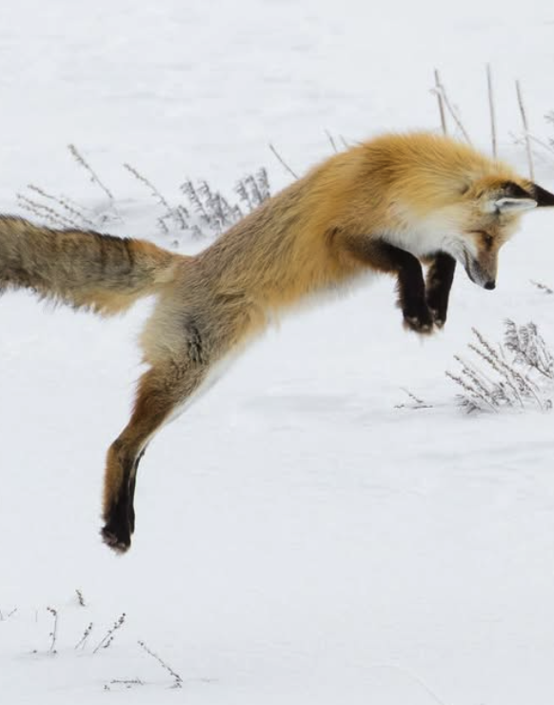
Merge database tables into single query
Perform LEFT JOINs using SQL directly from Python:
Join 'observations' with 'parks_updated' on 'park_name’
Then join that result with 'species_info' on 'scientific_name’
Print the first 3 rows from the final joined dataset to validate merge success

Slide 12
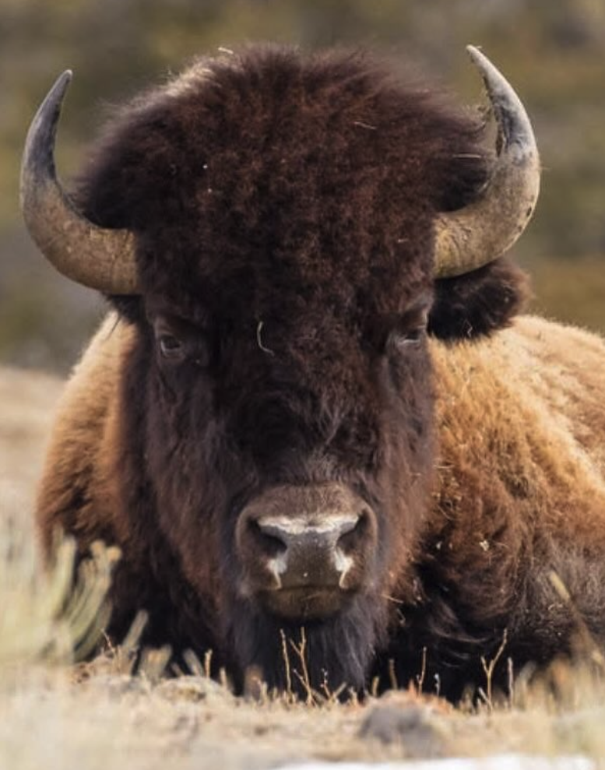
Reorder the columns to improve readability
Define current column headers that match SQL SELECT statement above
Convert that list to a Pandas DataFrame
Create new order of column headers and apply it to the DataFrame

Slide 13
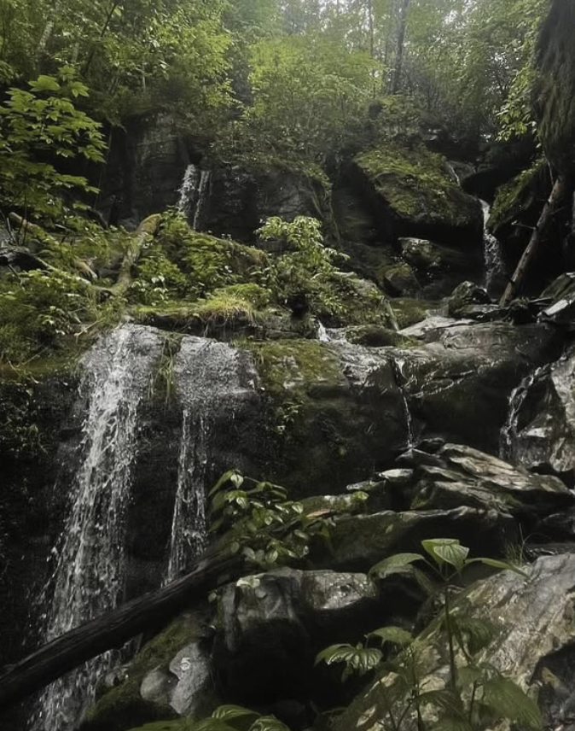
Save final merged dataset & close SQL connection
Save the final merged dataset to a CSV file in the 'resources' folder
Close the connection to the PostgreSQL database once all queries are complete

Slide 14
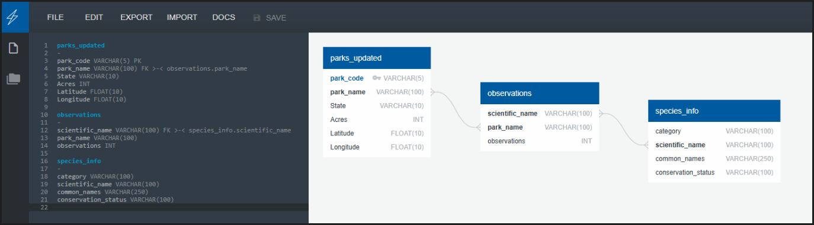
Database Design
We chose https://www.quickdatabasediagrams.com/ as our ERD tool

Slide 15
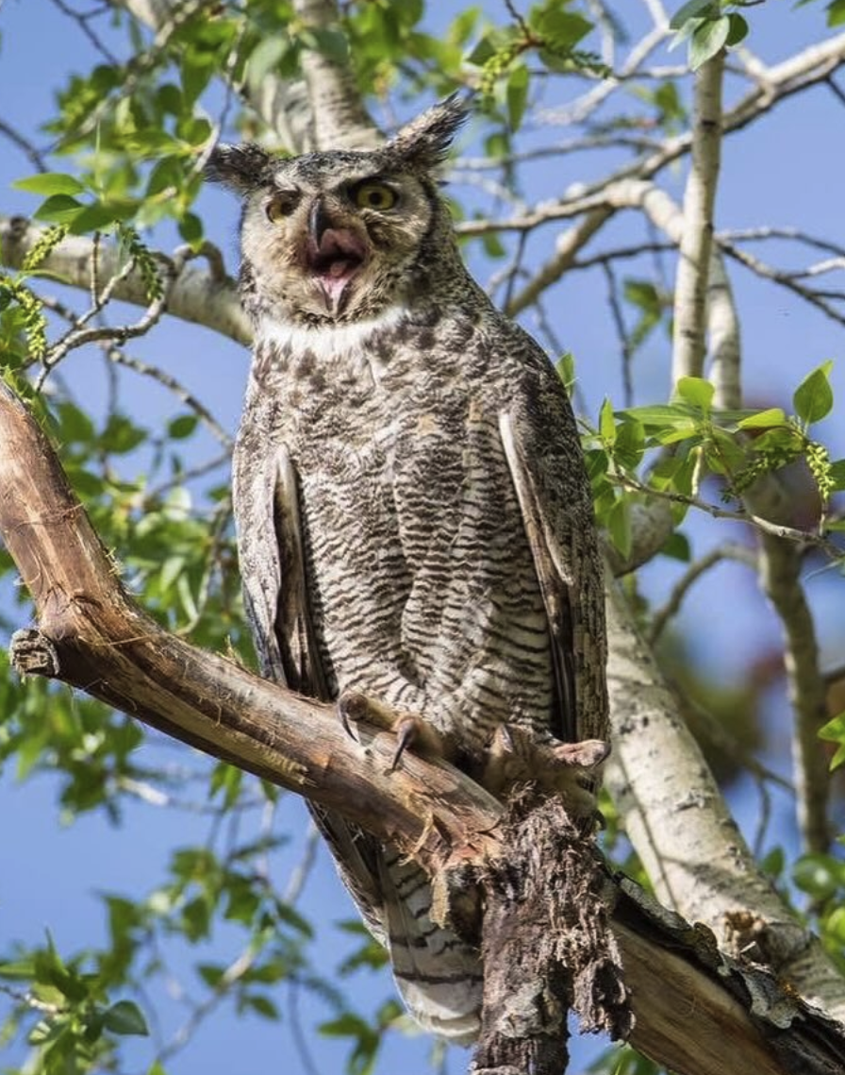
Ethical Considerations
Data Privacy: The datasets do not include personally identifiable information. All data pertains to publicly available environmental statistics and species info.
Conservation Awareness: We emphasize the importance of responsible ecological studies. Our goal is to raise awareness about endangered species and biodiversity patterns without exploiting or misrepresenting ecological data.
AI Usage Transparency: AI (ChatGPT) was used as a guide during project design, troubleshooting, and documentation. All generated content was reviewed by human team members.

Slide 16
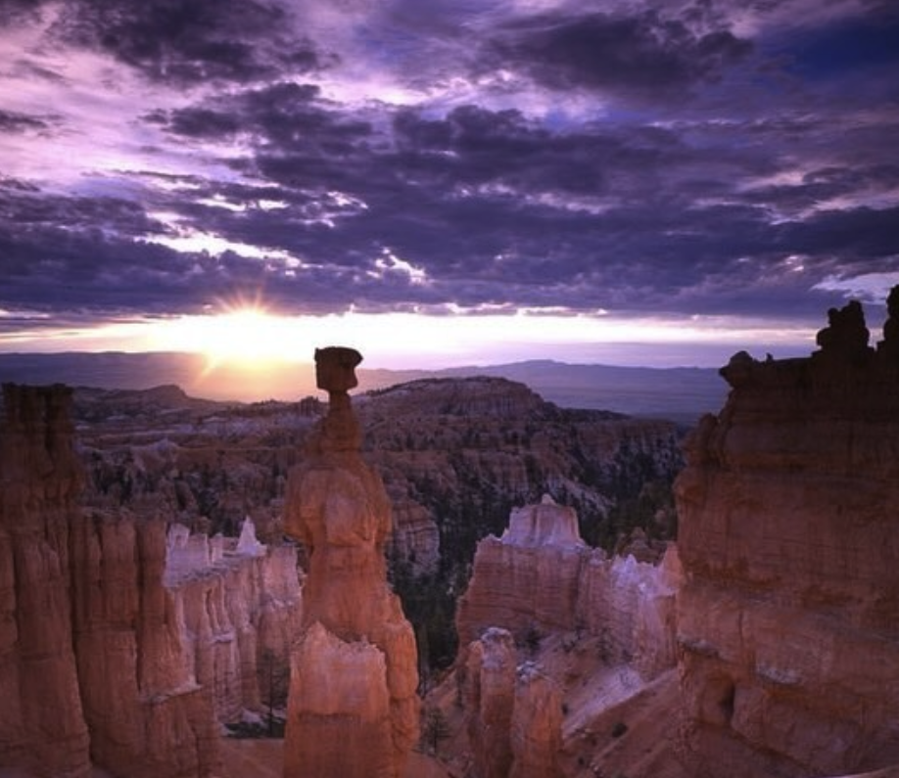
THANK YOU!

